Slide 1
Online Collaboration Tools
By Tram, Max, and Elysse

Slide 3
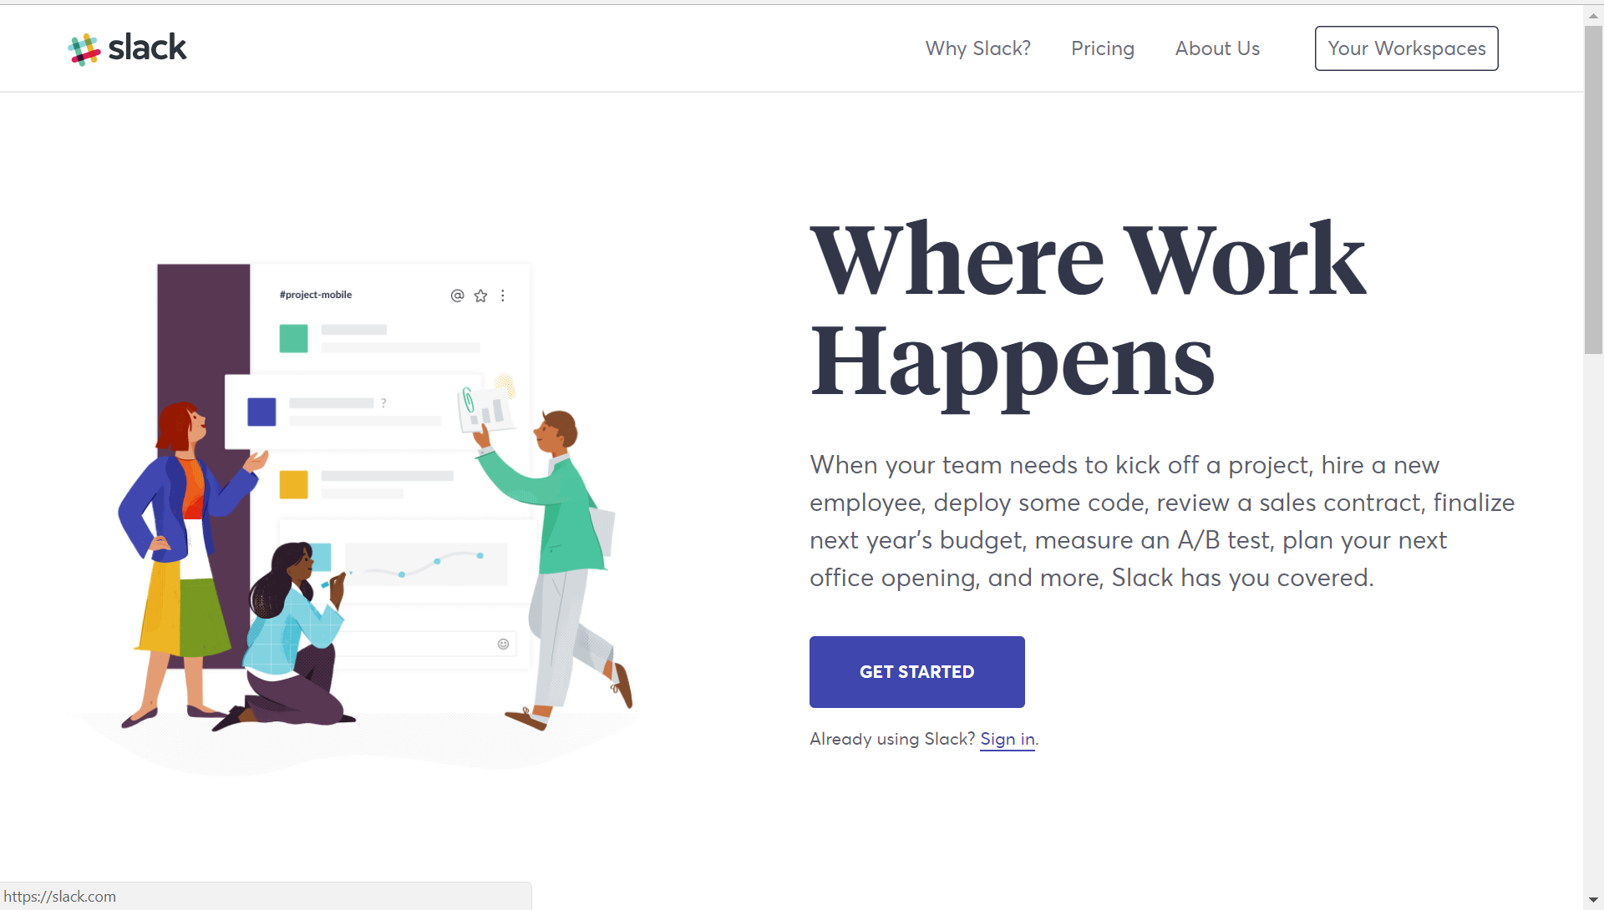

Slide 4
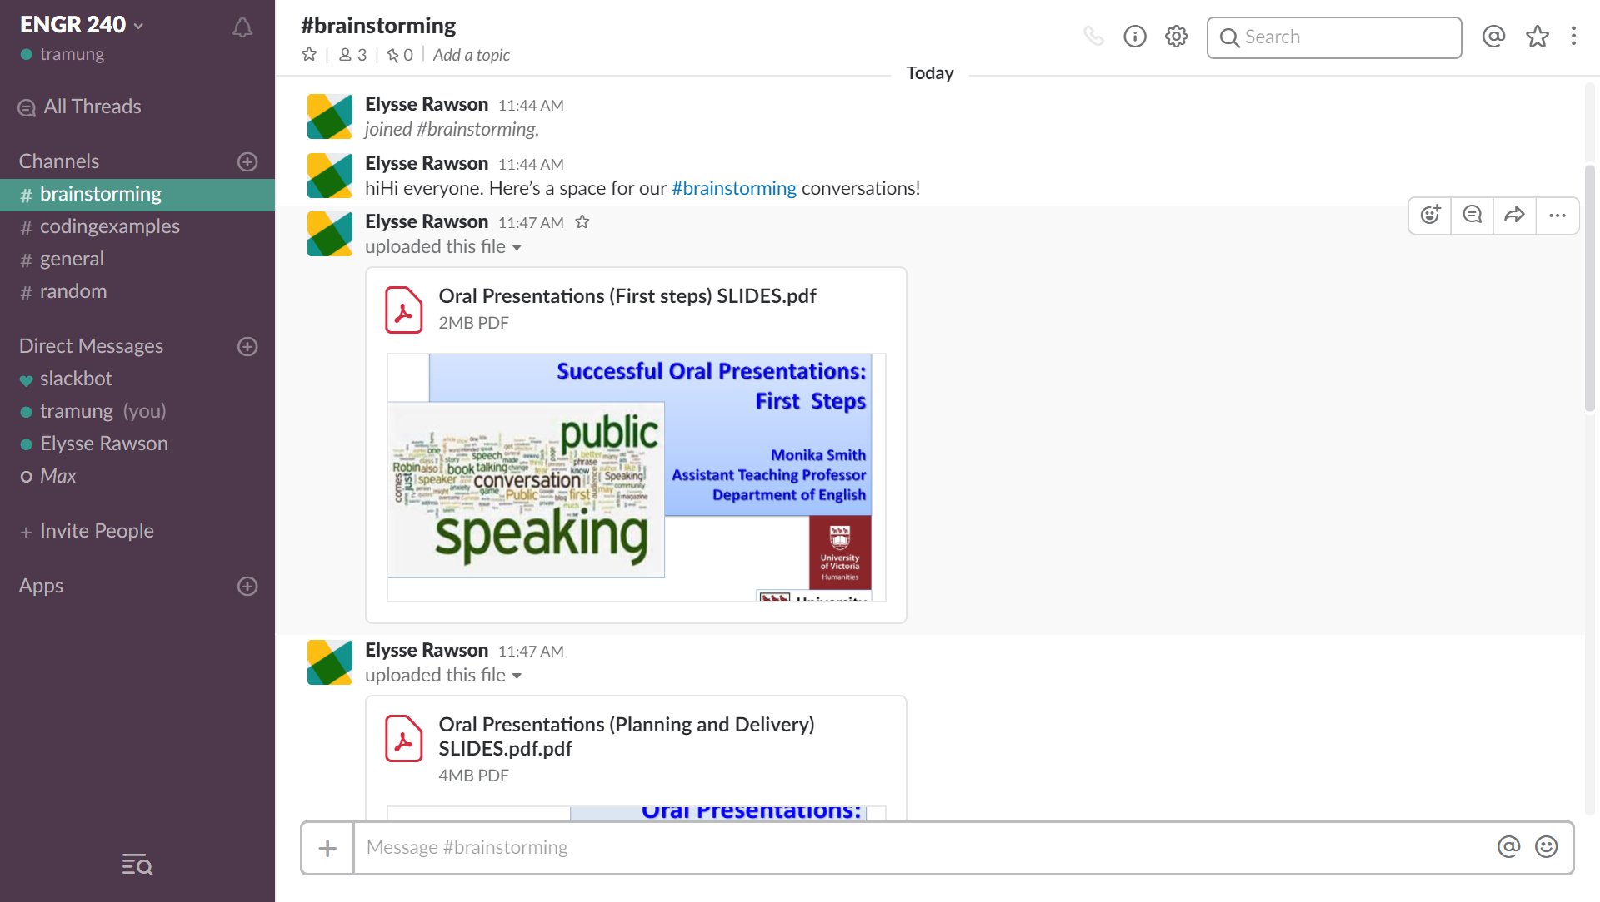

Slide 5
